Slide 1
UNIT IV
JOINS
Notes:
https://forms.gle/g3sQJTFpDQ4d3v3L6

Slide 2
JOIN Operation
A JOIN operation is used to combine data from two relations so that related information can be presented in a single table.
This operation is very important for any relational database with more than a single relation because it allows us to process relationships among relations.
Join operation is a combination of a Cartesian product followed by a selection process which satisfy certain condition.
Join is a combination of a Cartesian product followed by a selection process.
A join operation pairs two tuples from different relations, if and only if a given join condition is satisfied.
The JOIN operation is denoted by ⋈ (bow tie symbol).
The general form of a JOIN operation on two relations R(A1,A2, ...,An) and S(B1,B2, ...,Bm) is :
R ⋈ <join condition>S

Slide 3
JOIN Operation
The result of the JOIN is a relation Q:
with n+m attributes Q(A1,A2, ...,An,B1,B2,... ,Bm) in that order;
Q has one tuple for each combination of tuples—one from R and one from S—whenever the combination satisfies the join condition.
Difference between CARTESIAN PRODUC T and JOIN.
In JOIN, only combinations of tuples satisfying the join condition appear in the result, whereas in the CARTESIAN PRODUCT all combinations of tuples are included in the result.
The join condition is specified on attributes from the two relations R and S and is evaluated for each combination of tuples. Each tuple combination for which the join condition evaluates to TRUE is included in the resulting relation Q as a single combined tuple.

Slide 4
JOIN Operation
If no combination of tuples satisfies the join condition, the result of a JOIN is an empty relation with zero tuples.
In general, if R has n_{R} tuples and S has n_{s} tuples, the result of a JOIN operation R<join condition> S will have between zero and n_{R} * n_{s} tuples.
The expected size of the join result divided by the maximum size n_{R} * n_{s} leads to a ratio called join selectivity, which is a property of each join condition
If there is no join condition, all combinations of tuples qualify and the JOIN degenerates into a CARTESIAN PRODUCT, also called CROSS PRODUCT or CROSS JOIN.

Slide 5

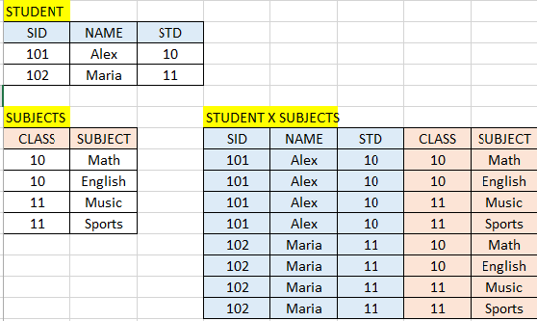
JOIN Operation - Example

Slide 6
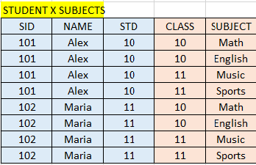
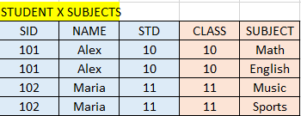
JOIN Operation - Example
STUDENT ⋈ Student.Std = Subject.Class SUBJECT

Slide 7
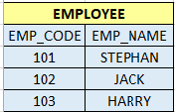
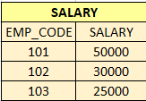
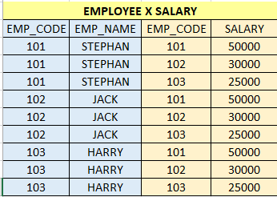

JOIN Operation - Example
EMPLOYEE ⋈EMPLOYEE.EMP_CODE= SALAY.EMP_CODE SALARY

Slide 8
JOIN Operation - TYPES
A Join operation combines two tuples from two different relations, if and only if a given condition is satisfied..
There are mainly two types of join which are further divided as follows:
1) Inner Join
Natural Join
Theta Join
Equi Join
2) Outer Join
Left Outer Join
Right Inner Join
Full Outer Join

Slide 9
JOIN Operation – INNER JOINS
1) Inner Join
Inner join is a type of join in which only those tuples are selected which fulfill the required conditions.
All those tuples which do not satisfy the required conditions are excluded.
Natural Join (⋈)
We can perform a Natural Join only if there is at least one common attribute that exists between two relations. In addition, the attributes must have the same name and domain.
Natural Join is a join which is performed if there is a common attribute between the relations.
Notation: R1 ⋈ R2 where R1 and R2 are two relations.
Natural join acts on those matching attributes where the values of attributes in both the relations are same

Slide 10
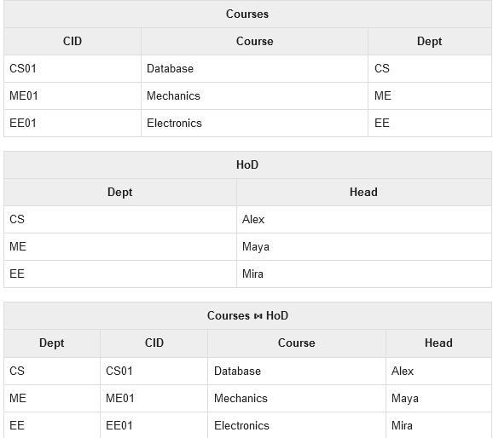
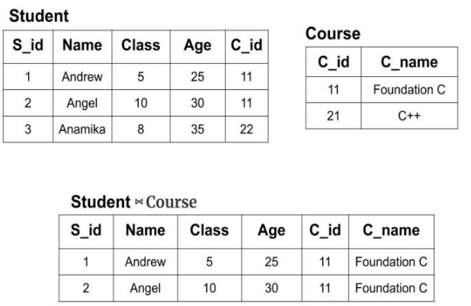
JOIN Operation - TYPES
Natural Join (⋈)

Slide 11

JOIN Operation - TYPES
Theta Join
This is same as EQUI JOIN but it allows all other operators like >, <, >= etc.
Theta join is a join which combines the tuples from different relations according to the given theta condition.
The join condition in theta join is denoted by theta (θ) symbol.
This join uses all kind of comparison operator.
Notation : where R1 and R2 are relations such that they don't have any common attribute.

Slide 12
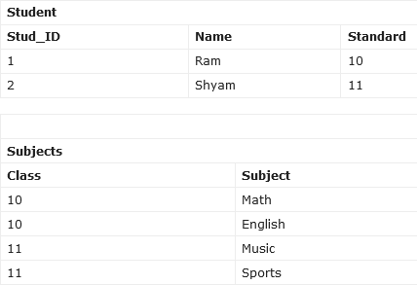
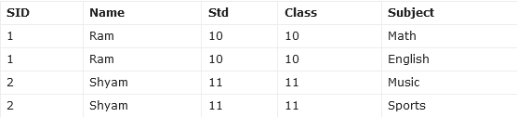
JOIN Operation - TYPES
Theta Join
STUDENT ⋈_{Student.Std = Subject.Class} SUBJECT

Slide 13
JOIN Operation - TYPES
Equi Join
Equi Join is a type of theta join where we use only the equality operator, unlike theta join where we can use any operator.
When Theta join uses equality operator for comparison, then it is called equi join. The above example of theta join is applicable for equi join..

Slide 14
JOIN Operation - TYPES
Equi Join
STUDENT ⋈_{Student.Std = Subject.Class} SUBJECT

Slide 15
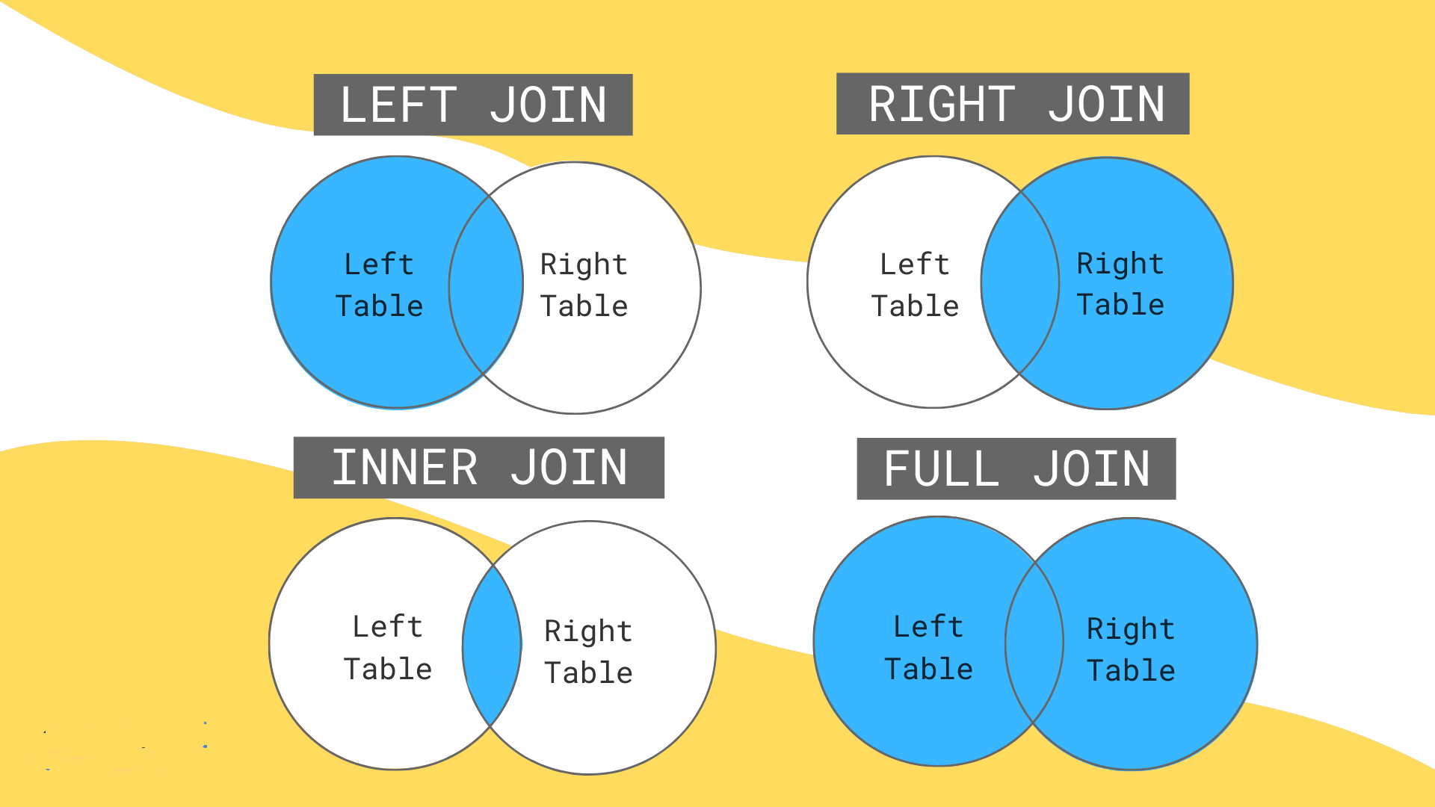
JOIN Operation - TYPES

Slide 16
JOIN Operation – OUTER JOINS
2) Outer Join
In Inner Join, matched rows are returned and unmatched rows are not returned.
In an outer join, along with tuples that satisfy the matching criteria, we also include some or all tuples that do not match the criteria.
Based on the tuples that are added from left, right or both the tables, the outer join is further divided into three types.
Left Outer Join
Right Inner Join
Full Outer Join

Slide 17
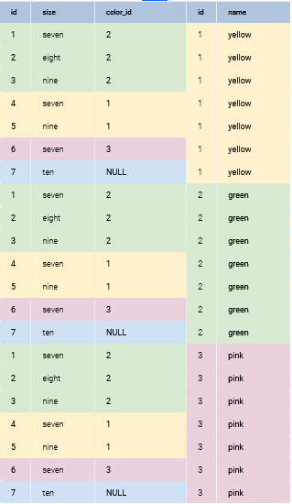
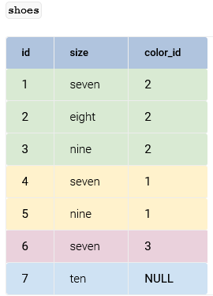
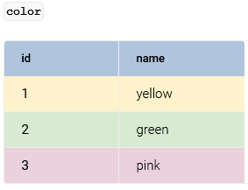
CARTESIAN/ CROSS PRODUCT
Notes:
In this example, INNER JOIN joins records from the shoes table with records from the color table through the color_id column from the shoes table. The values in this column are the same as those in the id column of the color table, so it produces the intended result set. Have a look at the following query:
SELECT * FROM shoes INNER JOIN color ON color.id = shoes.color_id;
How INNER JOIN Works
In this example, INNER JOIN joins records from the shoes table with records from the color table through the color_id column from the shoes table. The values in this column are the same as those in the id column of the color table, so it produces the intended result set. Have a look at the following query:
SELECT * FROM shoes INNER JOIN color ON color.id = shoes.color_id; The SELECT statement takes all records from the table listed after the FROM clause – in this case, the shoes table. Then there is an INNER JOIN with the name of the table we want to match records with (i.e. the color table). The ON predicate states the matching condition, which records from both tables must have. Here the condition is that the id field from the color table and the color_id field from the shoes table must have matching values. If a record doesn't have a match, it will be left out of the results.

Slide 18


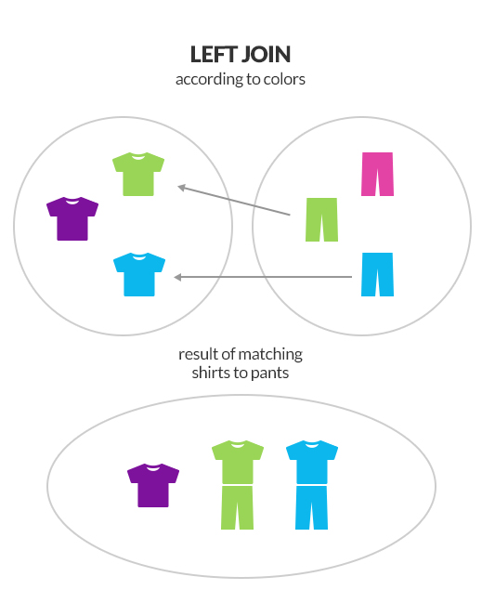
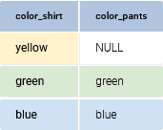
LEFT OUTER JOIN
The LEFT OUTER JOIN retrieves all records from the first (left) table and matches them to records from the second (right) table. Any non-matching records from the left table are also selected, but with NULL values where the right table records would be.
Notation: R1⟕ R2 where R1 and R2 are relations
SHIRT PANTS
With LEFT JOIN, all shirts and any matching pants were returned.
SHIRT ⟕ shirt.color_shirt= pants.color_pants PANTS
Notes:
select *
from shirt LEFT OUTER JOIN PANT
ON scolor = pcolor;

Slide 19
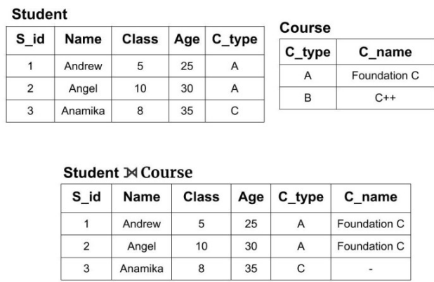
JOIN Operation – OUTER JOINS
Left Outer Join (⟕)
Left Outer Join is a type of join in which all the tuples from left relation are included and only those tuples from right relation are included which have a common value in the common attribute on which the join is being performed..
We can see that the new resulting table has all the tuples from the Student table but it doesn't have that tuple from the course table whose attributes values was not matching. Also, it fills the table with the null value for those columns whose value is not defined.

Slide 20
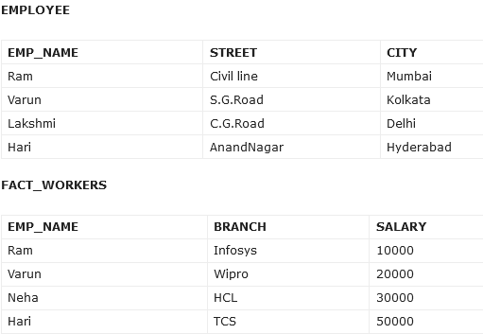
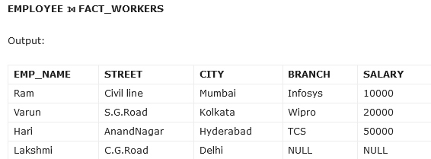
JOIN Operation – OUTER JOINS
Left Outer Join (⟕)
.

Slide 21
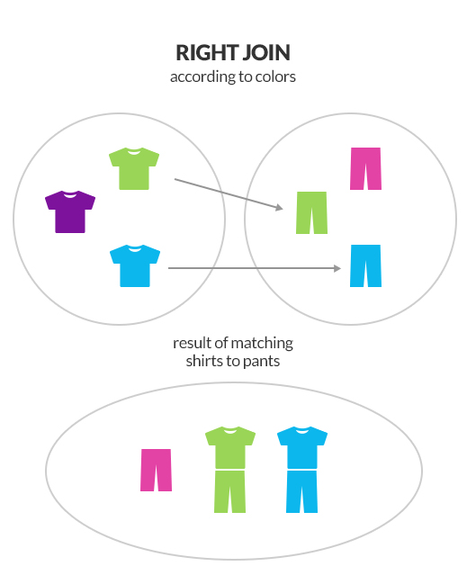
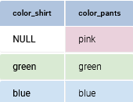
RIGHT OUTER JOIN
A RIGHT JOIN returns all rows from the right table. If there are no matches in the left table, NULL values are returned for those columns.
Notation: R1 ⟖ R2 where R1 and R2 are relations
SHIRT PANTS
With RIGHT JOIN, all pants and any matching shirts were returned.
SHIRT ⟖ shirt.color_shirt= pants.color_pants PANTS
Notes:
select *
from shirt RIGHT OUTER JOIN PANT
ON scolor = pcolor;

Slide 22
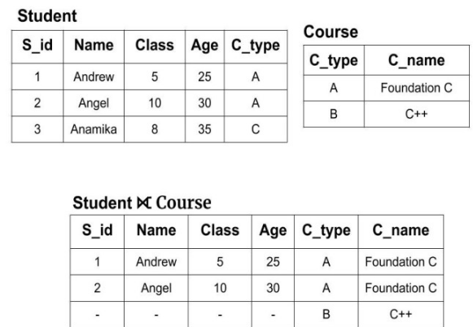
JOIN Operation – OUTER JOINS
Right Outer Join (⟖)
Right Outer Join is a type of join in which all the tuples from right relation are included and only those tuples from left relation are included which have a common value in the common attribute on which the right join is being performed.
We can see that the new resulting table has all the tuples from the Course table but it doesn't have that tuple from the Student table whose attributes values was not matching. Also, it fills the table with the null value for those columns whose value is not defined.

Slide 23
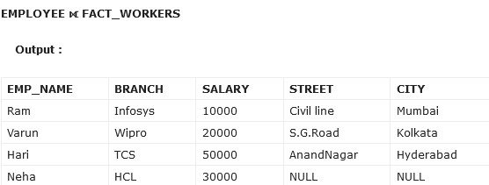
JOIN Operation – OUTER JOINS
Right Outer Join (⟖)

Slide 24
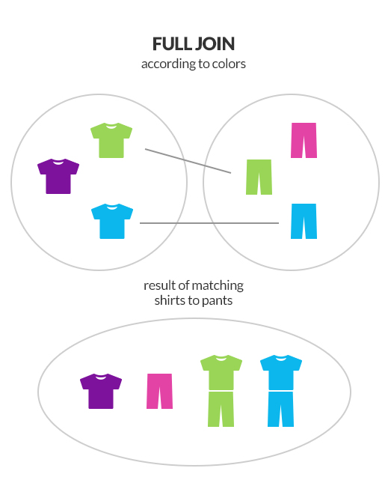
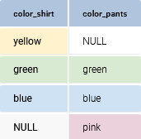
FULL OUTER JOIN
It shows all records from both tables. If possible, it will match the records; if not, a NULL will be shown where the matching record would be.
SHIRT PANTS
FULL JOIN returned all possible clothes: all shirts and all pants.
SHIRT ⟗ shirt.color_shirt= pants.color_pants PANTS
Notes:
select *
from shirt FULL OUTER JOIN PANT
ON scolor = pcolor;

Slide 25
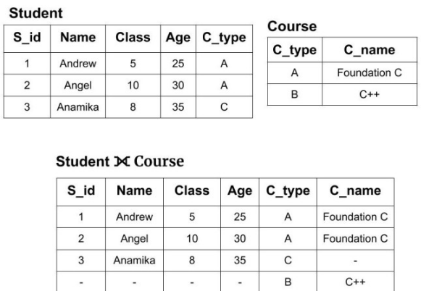
JOIN Operation – OUTER JOINS
Full Outer Join (⟗)
Full Outer Join is a type of join in which all the tuples from the left and right relation which are having the same value on the common attribute. Also, they will have all the remaining tuples which are not common on in both the relations.
Notation: R1 ⟗ R2 where R1 and R2 are relations
We can see that the new resulting table has all the tuples from the Course table as well as the Student table. Also, it fills the table with the null value for those columns whose value is not defined.

Slide 26
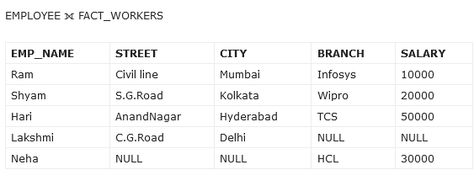
JOIN Operation – OUTER JOINS
Full Outer Join (⟗)

Slide 27
OUTER JOIN
An OUTER JOIN returns all the rows from one table and some or all of the rows from another table. There are three types of outer joins:
The three kinds of OUTER JOIN:
LEFT OUTER JOIN - returns every record in the left table and all matching records from the right table. If there’s no match found, a NULL is shown next to the unmatched record.
RIGHT OUTER JOIN - returns every record in the right table and all matching records from the left table. If there’s no match found, a NULL is shown next to the unmatched record.
FULL OUTER JOIN - returns all records from both tables. All unmatched records are paired with NULLs
Notes:
In this example, INNER JOIN joins records from the shoes table with records from the color table through the color_id column from the shoes table. The values in this column are the same as those in the id column of the color table, so it produces the intended result set. Have a look at the following query:
SELECT * FROM shoes INNER JOIN color ON color.id = shoes.color_id;
How INNER JOIN Works
In this example, INNER JOIN joins records from the shoes table with records from the color table through the color_id column from the shoes table. The values in this column are the same as those in the id column of the color table, so it produces the intended result set. Have a look at the following query:
SELECT * FROM shoes INNER JOIN color ON color.id = shoes.color_id; The SELECT statement takes all records from the table listed after the FROM clause – in this case, the shoes table. Then there is an INNER JOIN with the name of the table we want to match records with (i.e. the color table). The ON predicate states the matching condition, which records from both tables must have. Here the condition is that the id field from the color table and the color_id field from the shoes table must have matching values. If a record doesn't have a match, it will be left out of the results.

Slide 28
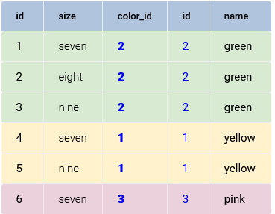
INNER JOIN
INNER JOIN combines data from multiple tables by joining them based on a matching record. This kind of join requires a joining condition - it returns only those records that match the join condition in both tables.
shoes ⋈ shoes.color_id = colors.id color
Notes:
In this example, INNER JOIN joins records from the shoes table with records from the color table through the color_id column from the shoes table. The values in this column are the same as those in the id column of the color table, so it produces the intended result set. Have a look at the following query:
SELECT * FROM shoes INNER JOIN color ON color.id = shoes.color_id;
How INNER JOIN Works
In this example, INNER JOIN joins records from the shoes table with records from the color table through the color_id column from the shoes table. The values in this column are the same as those in the id column of the color table, so it produces the intended result set. Have a look at the following query:
SELECT * FROM shoes INNER JOIN color ON color.id = shoes.color_id; The SELECT statement takes all records from the table listed after the FROM clause – in this case, the shoes table. Then there is an INNER JOIN with the name of the table we want to match records with (i.e. the color table). The ON predicate states the matching condition, which records from both tables must have. Here the condition is that the id field from the color table and the color_id field from the shoes table must have matching values. If a record doesn't have a match, it will be left out of the results.

Slide 29
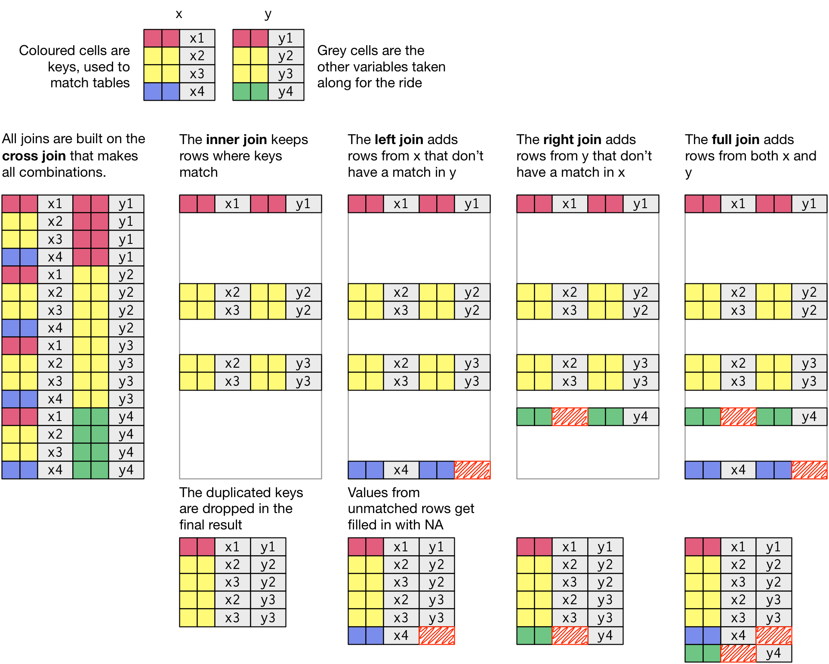

Slide 30
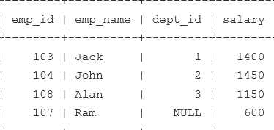
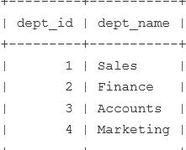
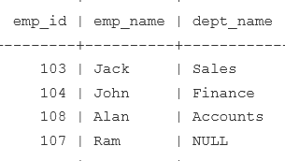
EXAMPLE
EMP DEPT
πemp_id, emp_name, dept_name (EMP ⟕ emp.dept_id = dept.dept_id DEPT)
LEFT OUTER join includes unmatched rows from the left table
Notes:
LEFT OUTER join includes unmatched rows from the left table while RIGHT OUTER join includes unmatched rows from the right side of the table. Read more: https://javarevisited.blogspot.com/2013/05/difference-between-left-and-right-outer-join-sql-mysql.html#ixzz6vw4CtbV2

Slide 31
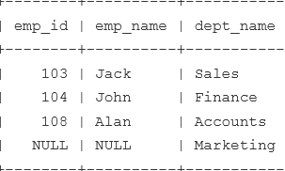
EXAMPLE
EMP DEPT
πemp_id, emp_name, dept_name (EMP ⟖ emp.dept_id = dept.dept_id DEPT)
RIGHT OUTER join includes unmatched rows from the right table

